Slide 1


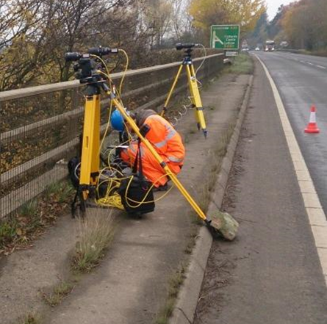
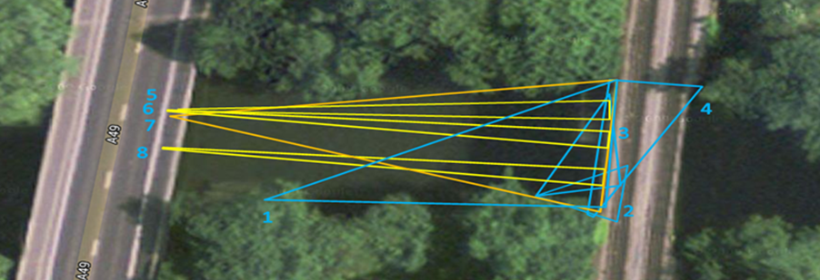
Bridge Monitoring
A bridge operating close to its deflection limits.
Also, specific areas of concern around bolted joints.
Global deflections calculated, including lateral (blue setup) and longitudinal (yellow setup).
Dynamic loading – real-time feedback, makes it simple to judge safe speed limit on structure.
In this case, a 4 camera setup, running at 40 Hz, from 45m away. 0.1mm resolution on global deflections, 0.02mm on detail – joint opening observed.

Slide 2
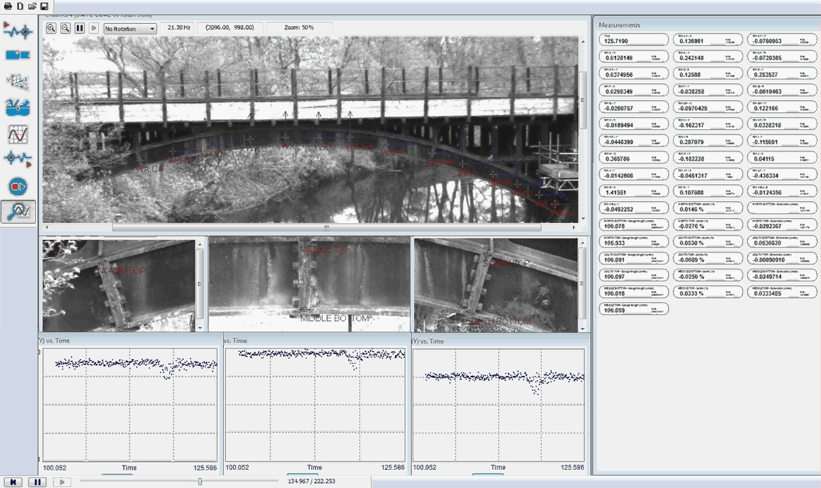
Software Visualization
Bridge Deflection

Slide 3
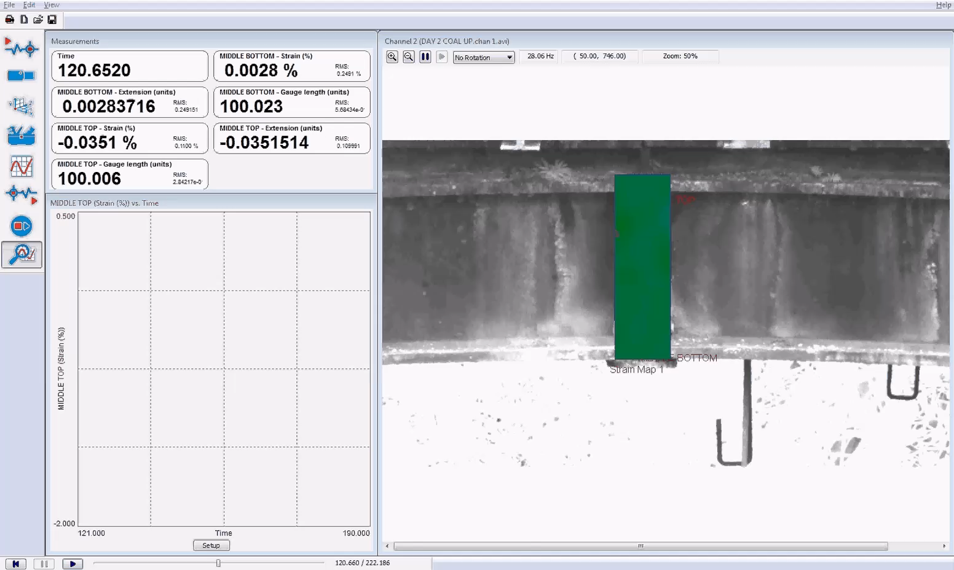
Software Visualization
Joint Opening

